Slide 1

Molecular Evolution
INSTITUTE OF NEUROSCIENCE
中国科学院神经科学研究所
Jun Yan
Laboratory of Network Computation
Institute of Neuroscience
Chinese Academy of Sciences

Slide 2
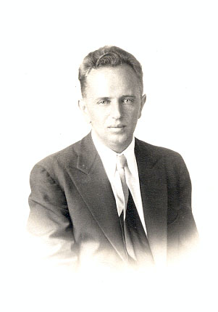
Nothing in biology makes sense except in the light of evolution
Theodosuis Dobzhansky

Slide 3
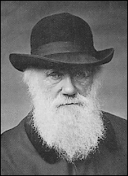
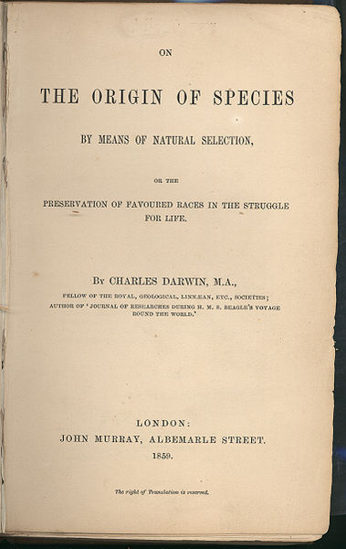
Charles Darwin (1809 – 1882)

Slide 4
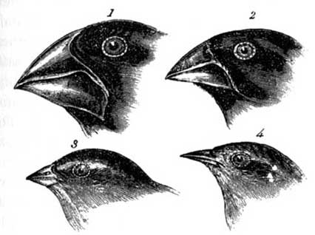
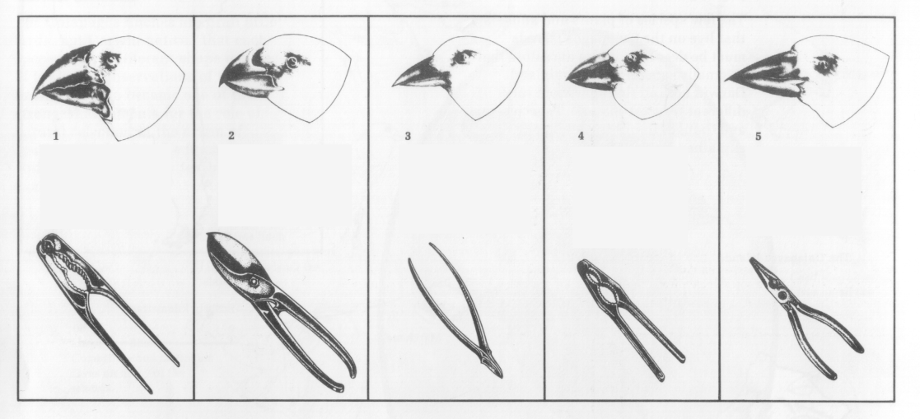
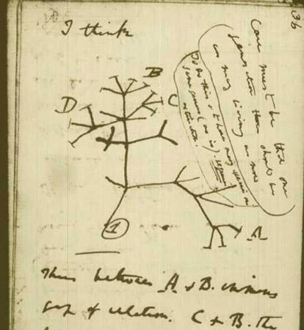
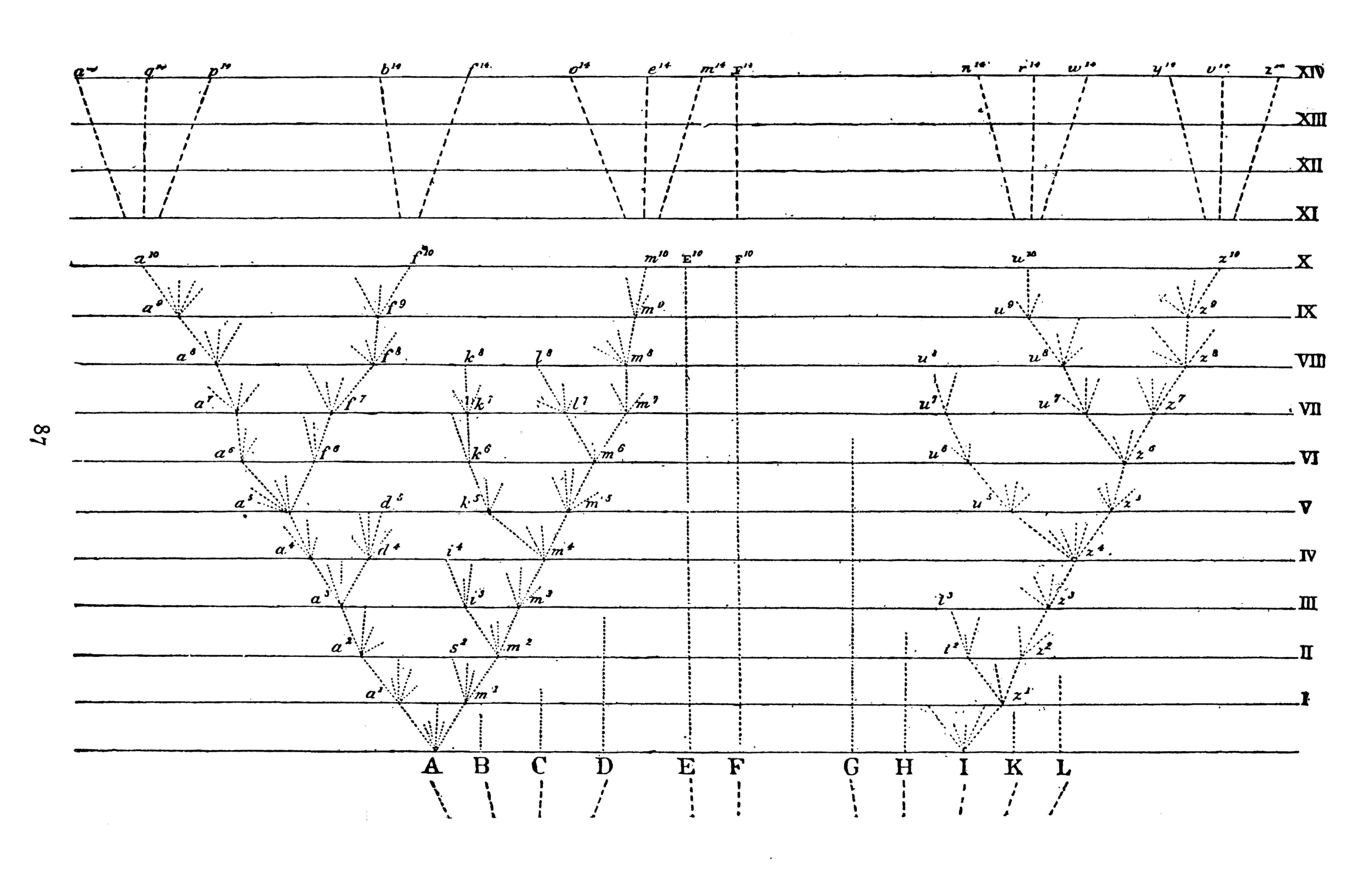
观察与分析
达尔文雀喙与人类工具
进化树与物种分歧图

Slide 5
Evolution as a Markov Process

Slide 6
Markov process

Slide 7
Markov process

Slide 8
Rate Matrix Q

Slide 9
Master Equation

Slide 10
Matrix Exponential

Slide 11
Matrix Exponential

Slide 14
DNA Evolution as a Markov Process

Slide 15
Jukes and Cantor Model

Slide 16
Jukes and Cantor Model

Slide 17
Divergence increases over time

Slide 18
Kimura 2 parameter model

Slide 19
Felsenstein Model

Slide 20
Tamura Nei Model (1993)

Slide 21
Likelihood Ratio Test

Slide 22
How to estimate rates?
Bayesian Analysis: includes prior knowledge and returns distributions of possible parameter values.
Maximum Likelihood: disregards prior knowledge and returns one estimate for each parameter.

Slide 23
贝叶斯定理(Bayes’ Theorem)
A是结果(data)，B是起因(model)。知道结果，推断起因。P(Br)是所谓先验概率(Prior)，往往不知道。

Slide 24
例子
假设你今年课不及格，你最有可能是那个所的？

Slide 25
研究所 | 不及格率P(A|Br) | 学生比例 P(Br)
生化所 | 0.05 | 0.33
神经所 | 0.04 | 0.17
营养所 | 0.025 | 0.13
健康所 | 0.05 | 0.13
药物所 | 0.02 | 0.17
计算所 | 0 | 0.07

Slide 26
研究所 | 不及格率P(A|Br) | 学生比例 P(Br)
生化所 | 0.05 | 0.33
神经所 | 0.04 | 0.17
营养所 | 0.025 | 0.13
健康所 | 0.05 | 0.13
药物所 | 0.02 | 0.17
计算所 | 0 | 0.07

Slide 27
研究所 | 不及格率P(A|Br) | 学生比例 P(Br) | 不及格学生所在所的概率P(Br|A)
生化所 | 0.05 | 0.33 | 0.45
神经所 | 0.04 | 0.17 | 0.18
营养所 | 0.025 | 0.13 | 0.09
健康所 | 0.05 | 0.13 | 0.18
药物所 | 0.02 | 0.17 | 0.09
计算所 | 0 | 0.07 | 0
答案：你最有可能是生化所的！

Slide 28
Example

Slide 29
Example

Slide 30
Example

Slide 31
Likelihood function for sequence evolution

Slide 32
Phylogenetic Tree (系统发育树）

Slide 33
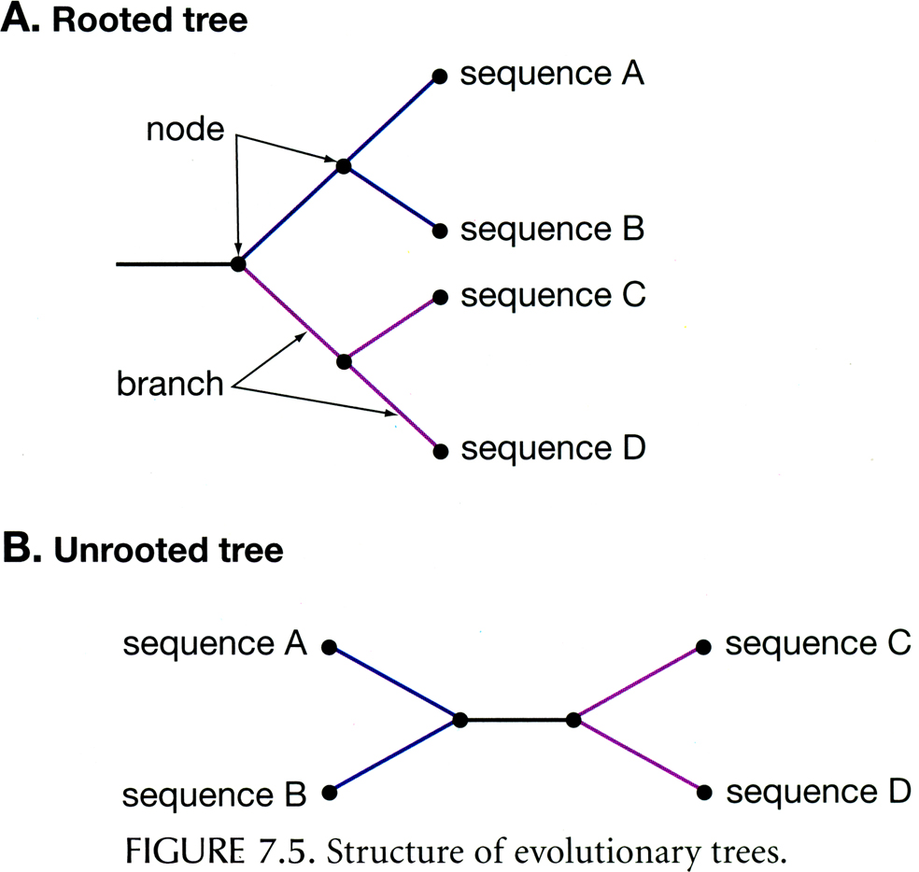

Slide 34
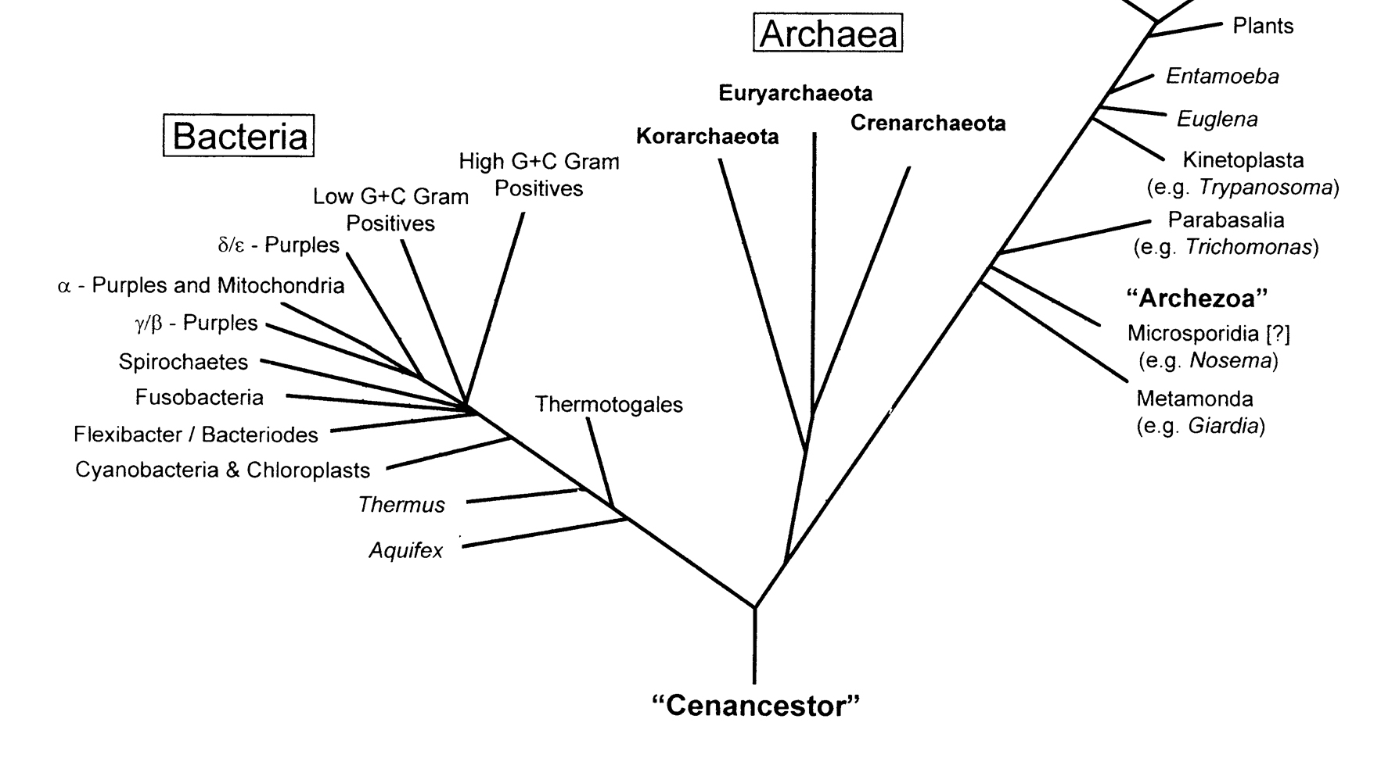

Slide 35
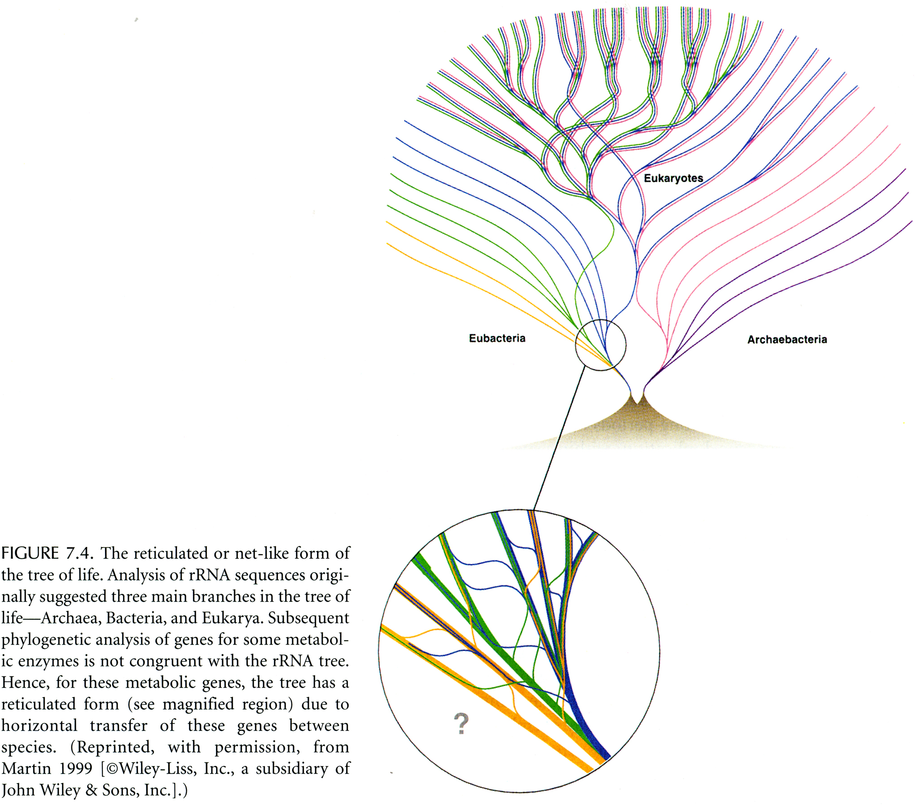

Slide 36
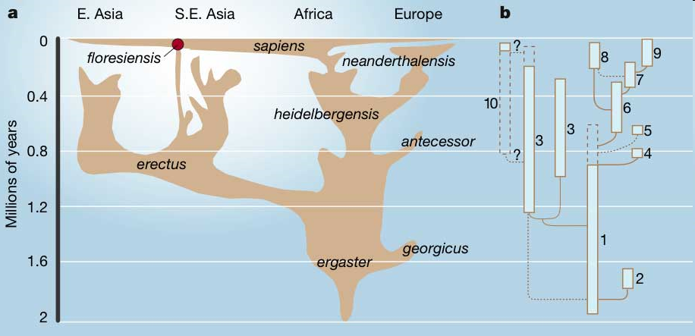
Homo
Lahr & Foley 2004
Notes:
But we didn‘t give up the hope to find DNA from yet another homin lineage. So we kept screening to eventually find some so far undescribed genetic lineage. As the most promissing area for that we consider East and Northern Asia, since the south of Asia as well as Africa are to warm and Europe was hold in the last couple of hundred thousand years by Neandertals. So we started a project in China to study chinese fossils and kept on screening other potenially human fossils from Russia and Central Asia.

Slide 37
分子系统发育分析的主要方法
最大简约法 (Maximum Parsimony)
距离矩阵法 (Distance Matrix)
最大似然法 (Maximum Likelihood)
4. 贝叶斯法 （Bayesian Inference)

Slide 38
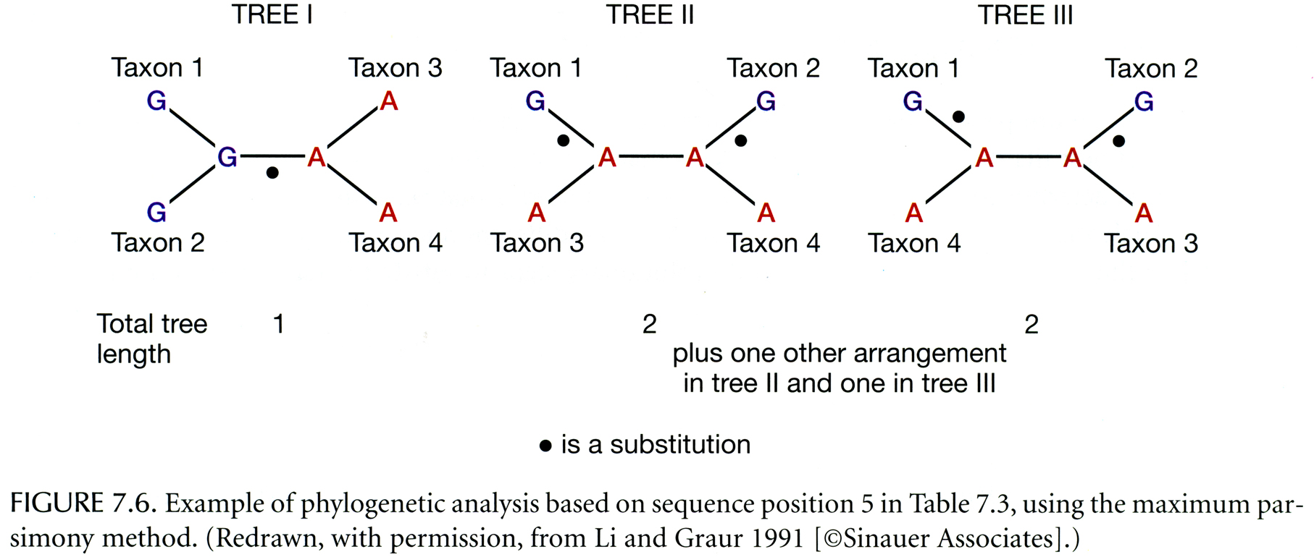
Maximum Parsimony

Slide 39
距离矩阵法
主要有UPGMA法 (类平均法) 和NJ法 (邻接法 ) 。
使用这两种方法前都必须获得一个对称距离矩阵 (m阶方阵) D = {d_{ij}}_{m×m}。
距离系数的公式很多。例如，Nei (1972)的遗传距离系数适用于限制性内切酶和同功酶数据，Jukes-Cantor 单参数距离系数和Kimura两参数模型距离系数则广泛用于各种序列数据。

Slide 40
距离聚类
输入: 物种/序列间距离矩阵
要点:
将最近的物种/序列聚合在一起
开始用于聚合的单元是独立的
在每次迭代中，将两个”最近”单元(距离最小)聚在一起形成一个新的聚合单元

Slide 41
UPGMA方法
(算术平均的不加权组对法)

Slide 42
 | A | B | C | D | E
A
B | 1.43
C | 2.65 | 4.24
D | 5.24 | 4.33 | 2.52
E | 3.08 | 1.57 | 2.19 | 3.02
找到距离矩阵中最小的距离，在这个例子中
具有最小距离的聚合单元是A 和 B.
Notes:
这个

Slide 43
2. 将 A 和 B 用树枝相连并给每一个分枝赋予一半的遗传距离
3. 从现在起，将(A+B) 作为一个单元考虑
0.715
A
0.715
B

Slide 44
 | A | B | C | D | E
A
B | 1.43
C | 2.65 | 4.24
D | 5.24 | 4.33 | 2.52
E | 3.08 | 1.57 | 2.19 | 3.02
4. 根据A和B的距离来重新计算遗传距离
例如， (A+B) 和 C 的距离是 (2.65+4.24)/2= 3.445
依次计算所有影响到的距离

Slide 45
 | A+B | C | D | E
A+B
C | 3.445
D | 4.785 | 2.52
E | 2.325 | 2.19 | 3.02
5. 重复上述步骤，找到下一个最小的距离。在这个例子中
是C 和 E之间的距离.

Slide 46
6. 将 C 和 E 用树枝相连，并给每一个树枝一半的遗传距离
7. 将 (C+E)作为 一个单元考虑
0.715
A
0.715
B
1.095
C
1.095
E
Notes:
从

Slide 47
 | A+B | C | D | E
A+B
C | 3.445
D | 4.785 | 2.52
E | 2.325 | 2.19 | 3.02
8. 基于C和E的距离的平均值，重新计算遗传距离
例如， (C+E) 和 D 的距离是 (2.52+3.02)/2 = 2.77 重新计算其他受到影响的距离

Slide 48
 | A+B | C+E | D
A+B
C+E | 2.885
D | 4.785 | 2.77
9. 现在重复这些步骤. 找到下一个最小的距离。这个例子中是(C+E) 和 D之间的距离.

Slide 49
10.将 (C+E) 和 D 用树枝，并给每一个分枝一半的遗传距离.
11. 将 (C+E+D)作为一个单元来考虑
0.715
A
0.715
B
1.385
D
1.095
C
1.385
1.095
E

Slide 50
12. 最后的距离是(A+B) 和 (C+D+E), 赋给每个树枝一半
的遗传距离
0.715
A
1.92
0.715
B
1.385
D
1.92
1.095
C
1.385
1.095
E

Slide 51
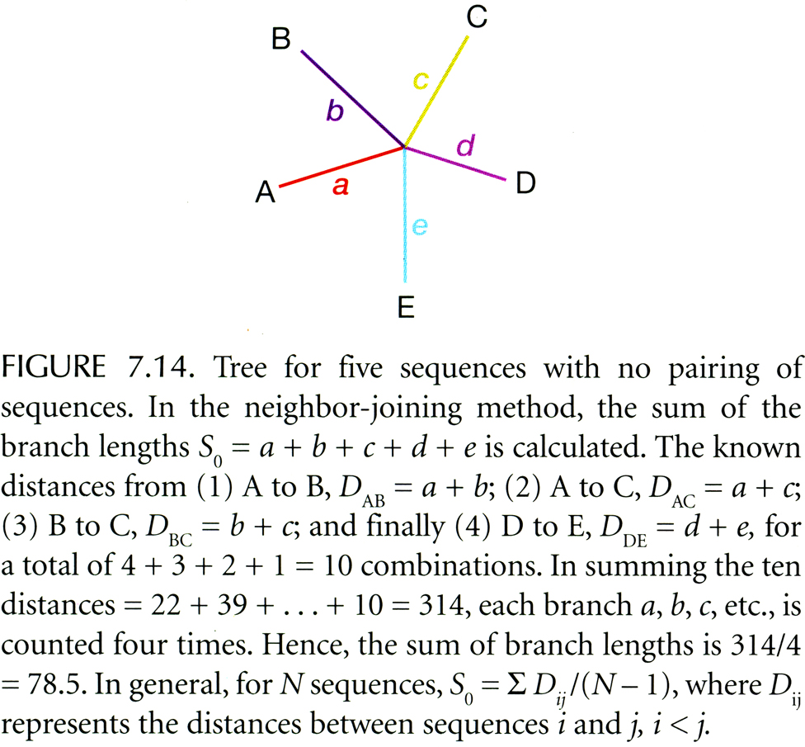
Neighbor Joining Method (NJ法)

Slide 52
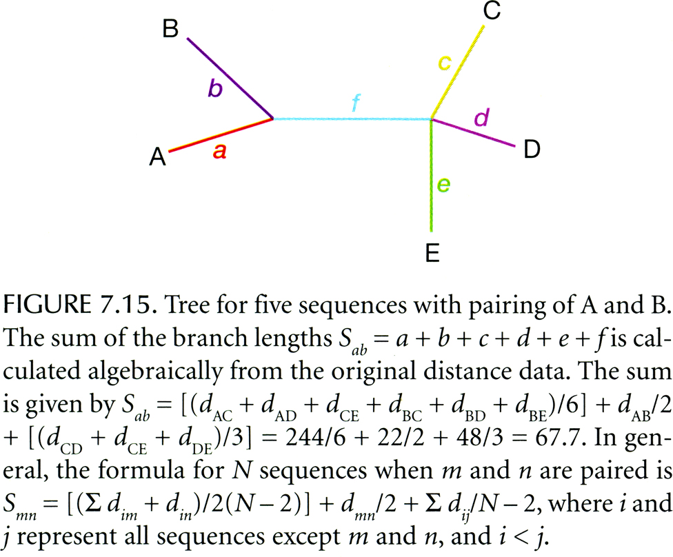
Neighbor Joining Method

Slide 53
Maximum Likelihood Method

Slide 54
适应性/选择性检测
KA: nonsynonymous substitution (非同义置换)
KS: synonymous substitution (同义置换)
>1 Positive selection (正选择)
KA / KS = 1 Neutral evolution (中性进化)
<1 Negative selection (负选择)

Slide 55
Ka/Ks 检验的两类方法
基于Maximum Parsimony原理的近似方法
Nei and Gojobori 为代表
(MEGA)
基于Maximum Likelihood原理
Ziheng Yang为代表
(PAML)

Slide 56
对基因的选择
‘Housekeeping Genes’.
Negative (Purifying) selection.
Change is Bad.
Genes that have a role in adaption.
Positive (Adaptive) selection.
Change is Good.
Selectively neutral genes
Genetic drift.

Slide 57
软件
1) PHYLIP
2) TREE-PUZZLE
3) MEGA
4) PAUP
5) PAML
6) TreeView

Slide 58
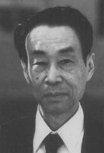
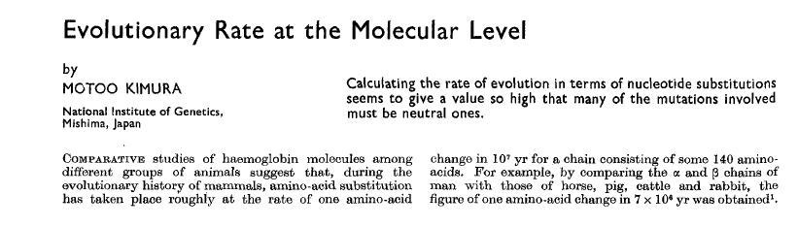
中性进化学说创立者
Motoo Kimura 木村资生（1924－1994）
Nature 1968，217：624－626

Slide 59
Kimura假设大多数的置换是中性的，或者说很小一部分变化是由于达尔文进化引起的
deleterious
advantages
deleterious
neutral
中性突变（等位基因）与野生型具有相同的适合度
Kimura (1968) Nature 217 624-626

Slide 60
Genetic drift

Slide 61
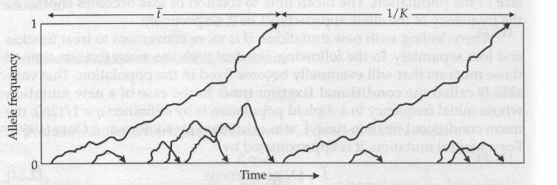
基因的命运
在分子水平，大多数进化的变化和同一个物种中的大多数变异不是由于选择造成的，而是由与自然选择等价的基因随机漂变造成的。
Graur & Li. Fundamentals of Molecular Evolution

Slide 62
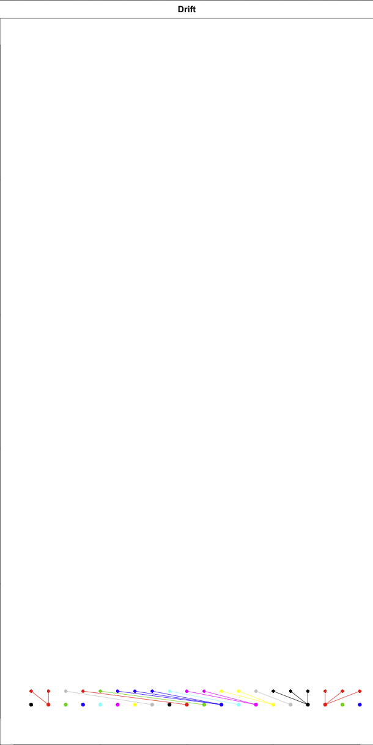
Wright-Fisher process
Each of N individuals has the same chance to be the offspring of N parents.
Constant pop size N
non-overlapping generations
In R: pop=sample(pop,rep=T)
offspring
parent

Slide 63
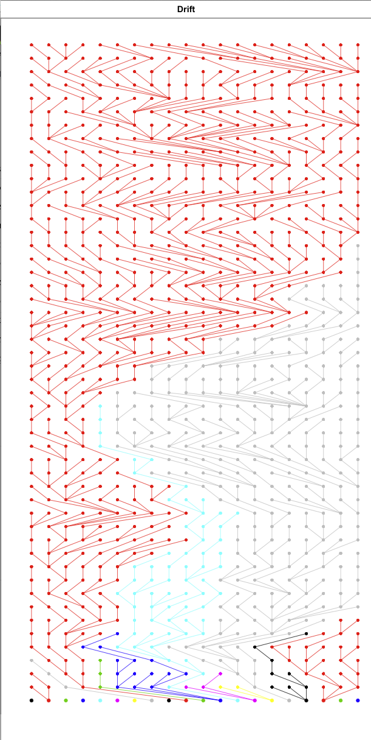
One lineage fixes
each of N has a chance
of 1/N

Slide 64
Moran process
Each step an individual is chosen to die, and to reproduce
Constant pop size
Overlapping generations

Slide 65
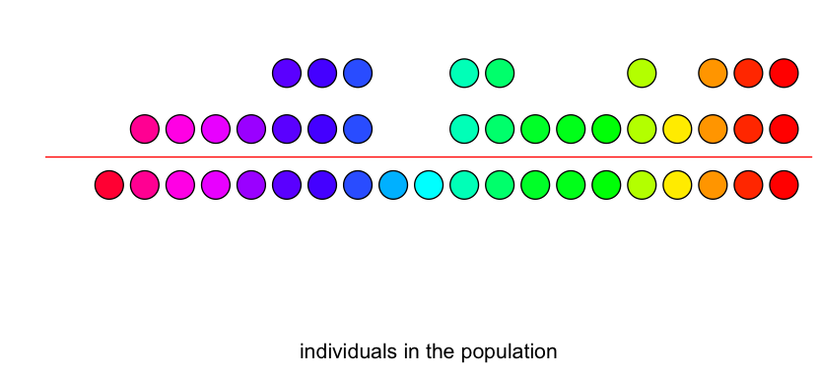
Real population are neither Moran nor Wright-Fisher
Example: each individual has 0, 1 or 2 offspring

Slide 66
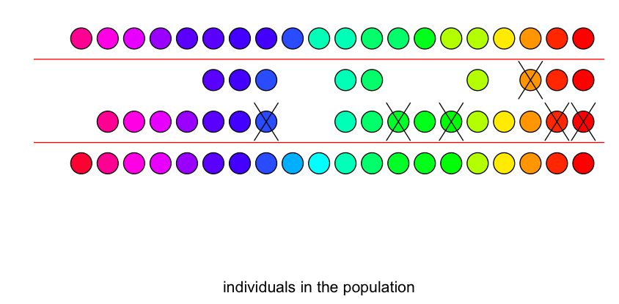
Real population are neither Moran nor Wright-Fisher
Example: each individual has 0, 1 or 2 offspring

Slide 67
Real population are neither Moran nor Wright-Fisher
We need a standard way to stretch time.
Effective population size: population size of Wright-Fisher process that would achieve same rate of change of variance N_{e}

Slide 68
Natural selection
Variation
Selection
Replication/transmission

Slide 69
Natural selection
Variation
Selection - Variation causes differences that are selected on.
Replication/transmission - the variants that cause differences that are selected on are transmitted.

Slide 70
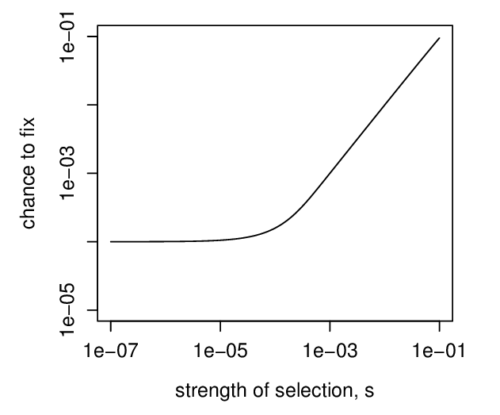
chance to fix:
selected
neutral – chance 1/N

Slide 71
Fitness
Fitness of an individual is something like:
Number of offspring (fecundity)
Survival chance (viability)
Number of grandchildren
Number of future lineages produced

Slide 72
Neutral
Neutral: s N << 1
Selected: s N >> 1
humans s N << 1, s << 1/20,000

Slide 73
Recombination
Every individual has two parents

Slide 74
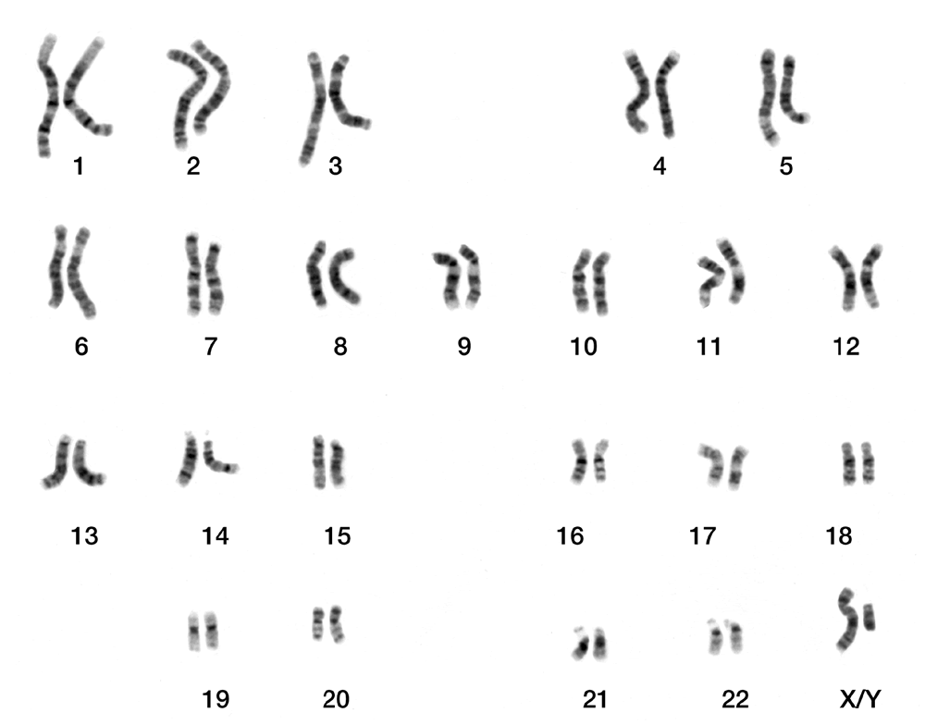

Slide 75
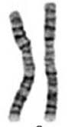
Recombination
grandparents
Parents
children
Notes:
Identical is not correct: corrrect is that the c

Slide 76
Recombination

Slide 77
Recombination

Slide 78
Recombination

Slide 79
Recombination

Slide 80
As we go along the genome, ancestry change

Slide 81
Population tree

Slide 82
Remark on clocks
There are 3 “independent” clocks:
Coalescence clock. Rate determined by N_{e}
Mutation clock. Mutations along coalescence trees – mu & N_{e}
Recombination clock – rec & N_{e}

Slide 83
Hitchhiking / Draft
Sites near regions that experience repeated bouts of positive selection will have hitchhiking.
Increased variance - smaller N_{e}
This is called “draft”
John H. Gillespie (1994/2001) The Causes of Molecular Evolution
Oxford Univ. Press

Slide 84
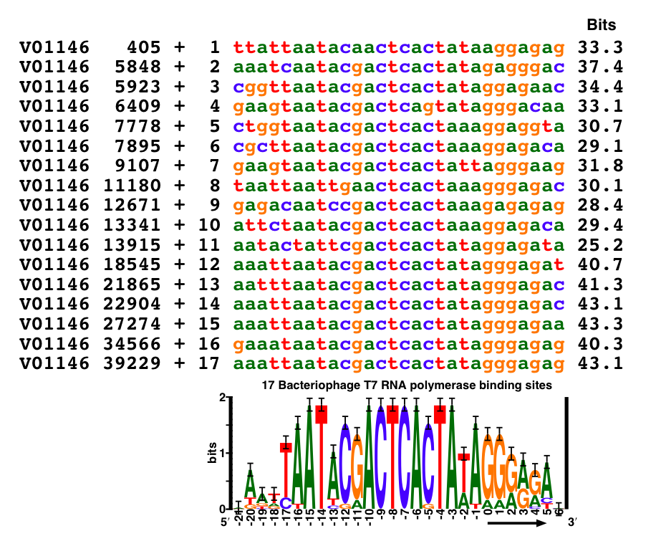
Conserved sites

Slide 85
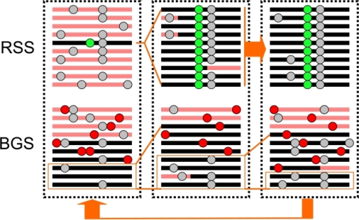
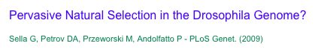
selective sweeps
background selection
hitchhiking allele
positive allele
negative allele
neutral allele

Slide 86
An Application of Markov process

Slide 87
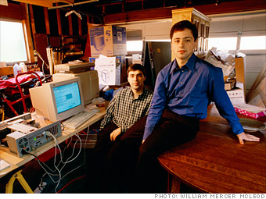
Larry Page and Sergey Brin in 1998

Slide 88


Slide 89

Notes:
The pagerank considers the global properties of the network. At the time of its development, there are only 10 million webpage. In 2015, there are 10 billion webpages in the world. Pagerank can handle the ranking of such large number of webpages efficiently.

Slide 90
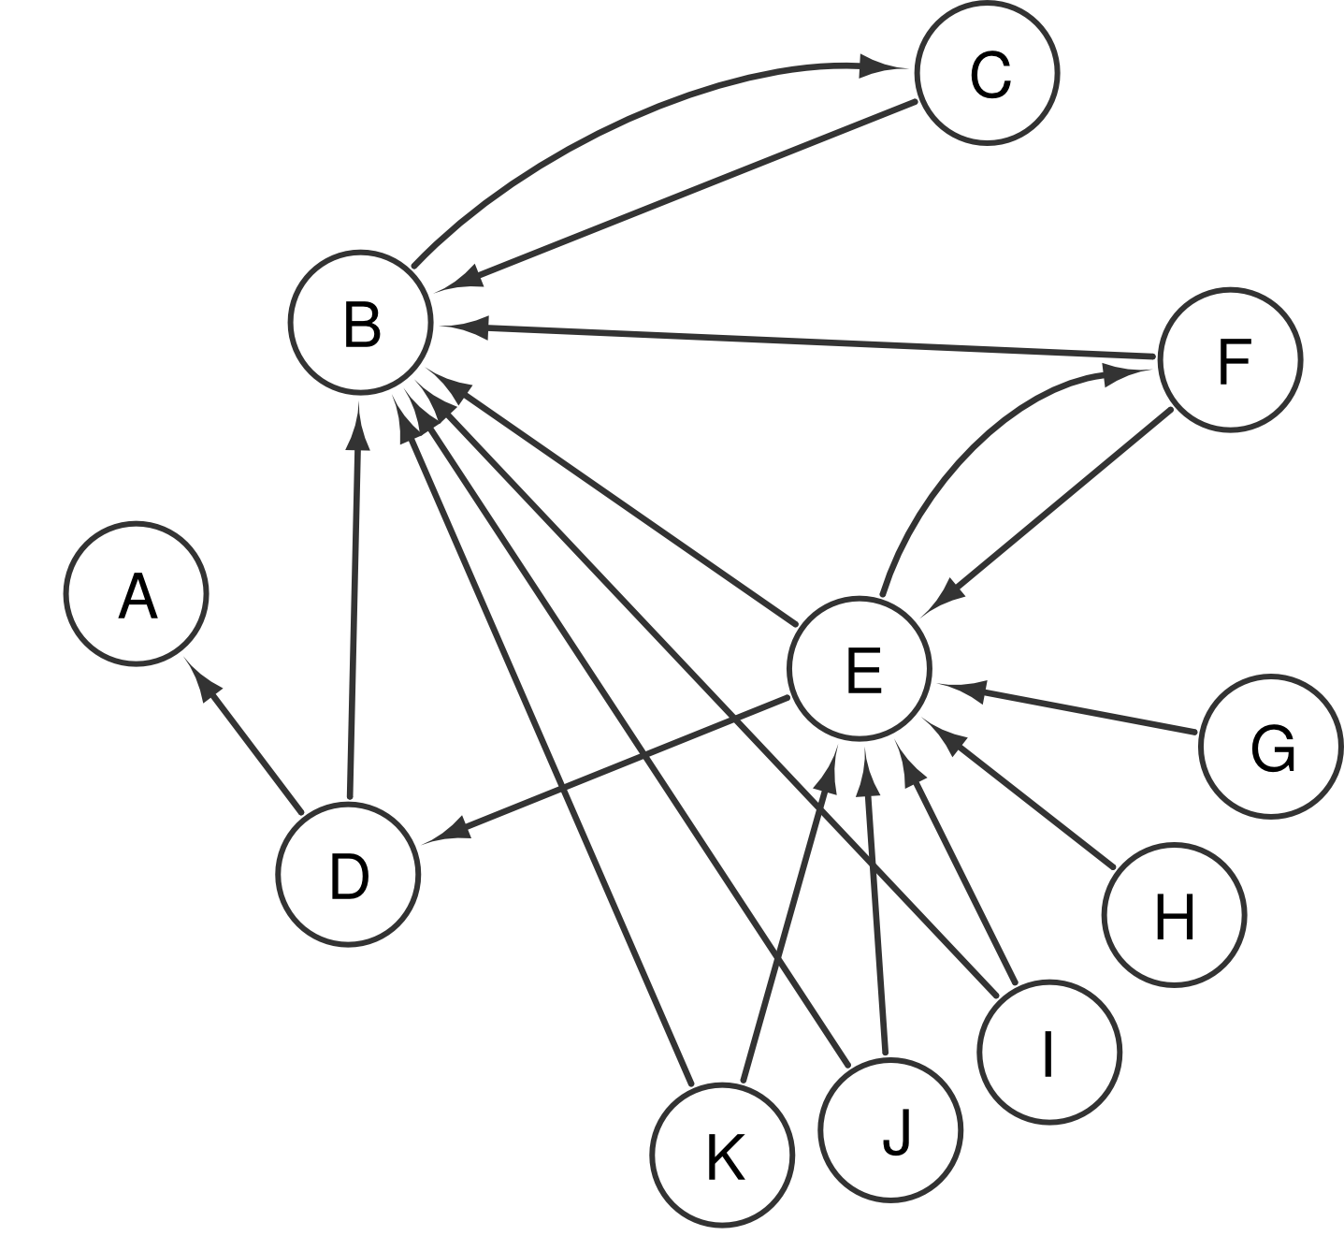
An example of world wide web

Slide 91
Random Surfer Model
is the probability to visit webpage

Slide 93
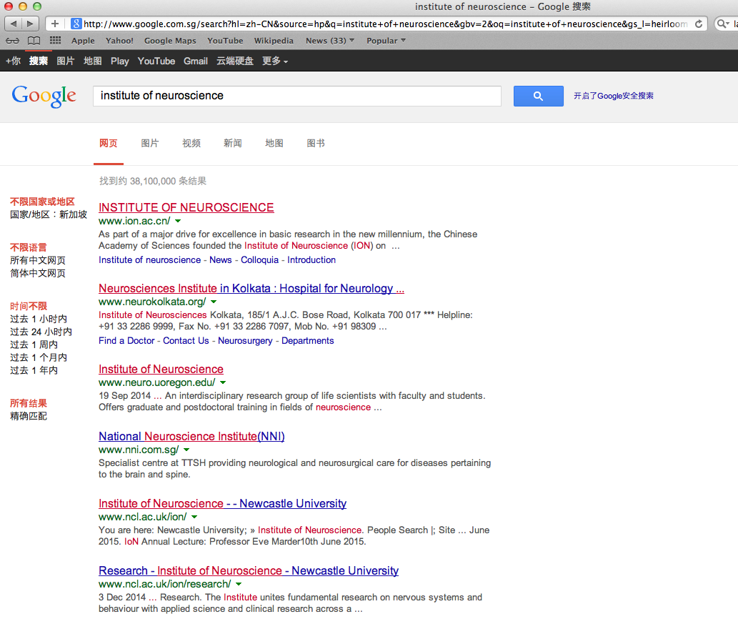
# 1

Slide 94
The Star Trek computer doesn't seem that interesting. They ask it random questions, it thinks for a while. I think we can do better than that.
------ Larry Page

